Slide 1
Chapter 12: Signal Conversion and Processing

Slide 2
Objectives
After studying this chapter, students should be able to:
Understand the process and purpose of Analog to Digital signal conversions, versa.
Explain how ADCs and DACs operate.
Explain the basic concepts of a digital signal processor (DSP).
Describe the basic architecture of a DSP.
Chapter 12: Signal Conversion and Processing

Slide 3
Contents
12.1. Analog-to-Digital Conversion
12.2. Methods of Analog-to-Digital Conversion
12.3. Methods of Digital-to-Analog Conversion
12.4. Digital Signal Processing
12.5. The Digital Signal Processor (DSP)
Chapter 12: Signal Conversion and Processing

Slide 4
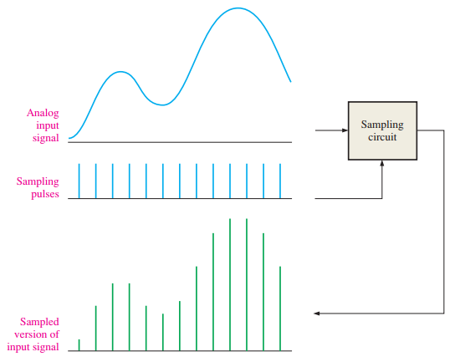
12.1. Analog-to-Digital Conversion
Sampling and Filtering
Sampling is the process of taking discrete measurements of an analog signal at regular intervals.
Each sample captures the amplitude of the signal at that instant.
The more samples taken → the more accurate the digital representation of the waveform.
Chapter 12: Signal Conversion and Processing

Slide 5

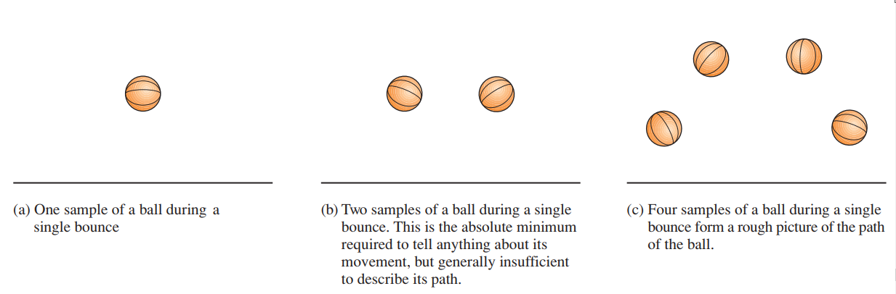
12.1. Analog-to-Digital Conversion
The Sampling Theorem To accurately represent an analog signal, the sampling frequency (fₛₐₘₚₗₑ) must be greater than at least twice the highest frequency (fₐ₍ₘₐₓ₎) of the analog signal.
Chapter 12: Signal Conversion and Processing

Slide 6
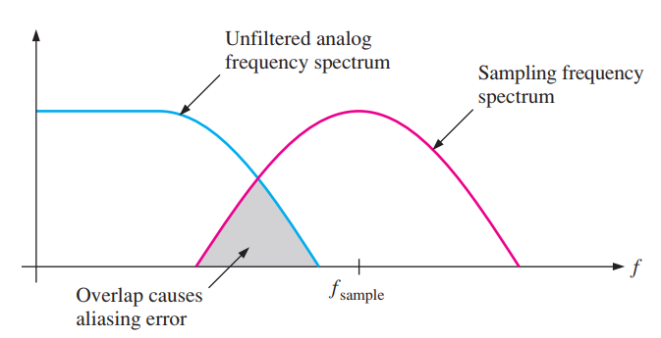
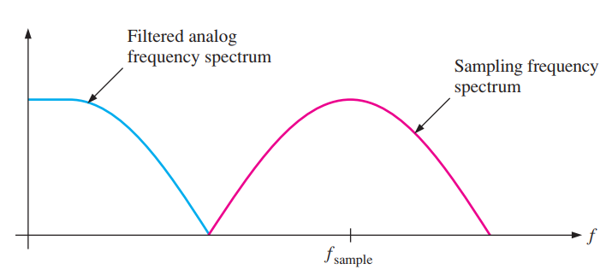
12.1. Analog-to-Digital Conversion
The Need for Filtering Low-pass filters are essential to remove frequency components above the Nyquist frequency.
If high-frequency signals are not filtered, aliasing occurs.
Use an anti-aliasing filter (low-pass) to eliminate unwanted high frequencies before sampling.
Chapter 12: Signal Conversion and Processing

Slide 7
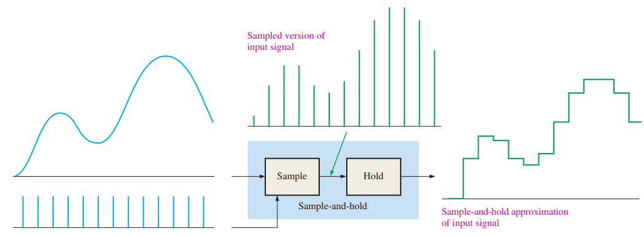
12.1. Analog-to-Digital Conversion
Holding the Sampled Value This sample-and-hold operation results in a “stairstep” waveform that approximates the analog input waveform
Chapter 12: Signal Conversion and Processing

Slide 8
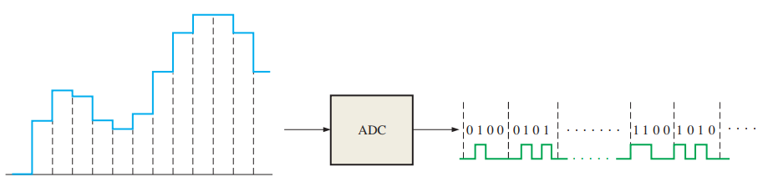

12.1. Analog-to-Digital Conversion
Analog-to-Digital Conversion Analog-to-digital conversion is the process of converting the output of the sample and hold circuit to a series of binary codes that represent the amplitude of the analog input at each of the sample times.
Chapter 12: Signal Conversion and Processing

Slide 9
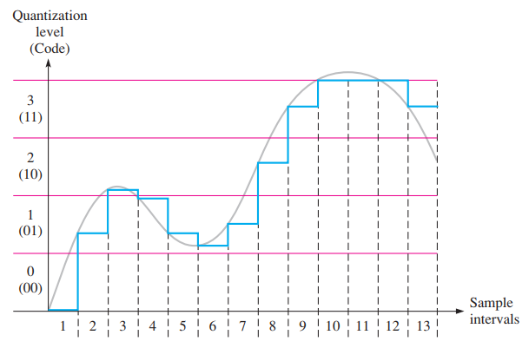
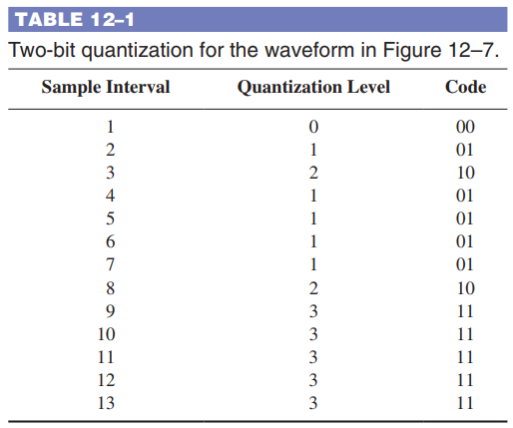
12.1. Analog-to-Digital Conversion
Quantization The process of converting an analog value to a code is called quantization. During the quantization process, the ADC converts each sampled value of the analog signal to a binary code.
Chapter 12: Signal Conversion and Processing

Slide 10
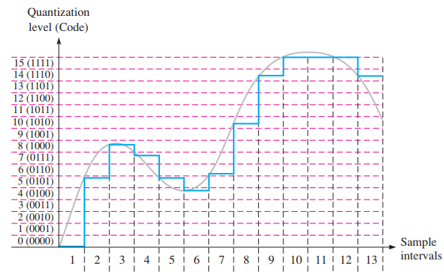
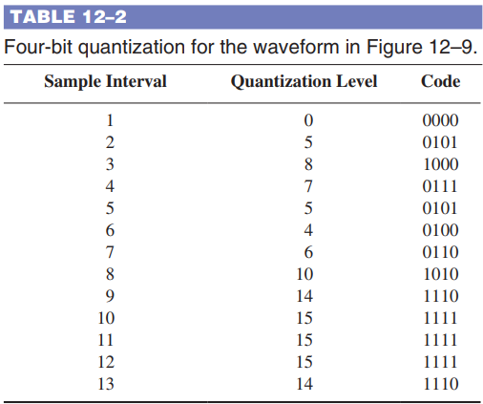
12.1. Analog-to-Digital Conversion
Quantization Increasing the number of quantization bits greatly enhances the fidelity of the reconstructed analog signal.
Chapter 12: Signal Conversion and Processing

Slide 11
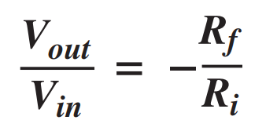
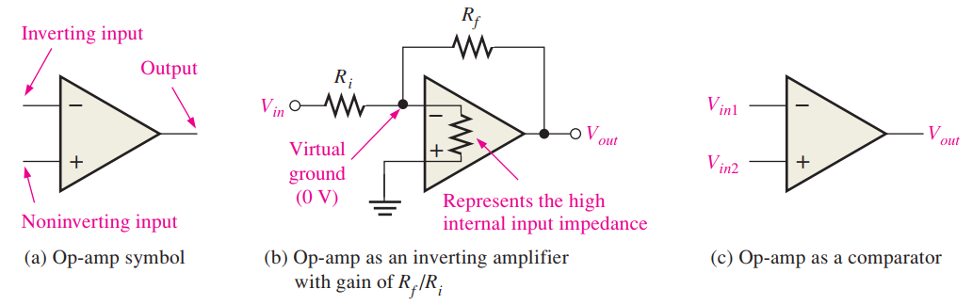
12.2. Methods of Analog-to-Digital Conversion
A Quick Look at an Operational Amplifier
Chapter 12: Signal Conversion and Processing

Slide 12
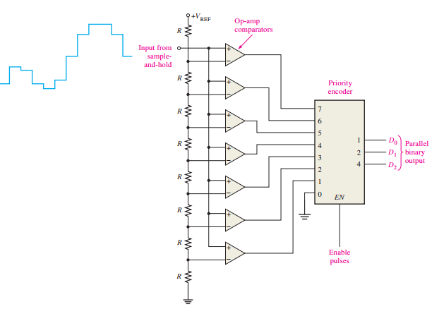
12.2. Methods of Analog-to-Digital Conversion
Flash (Simultaneous) Analog-to-Digital Converter
Chapter 12: Signal Conversion and Processing

Slide 13
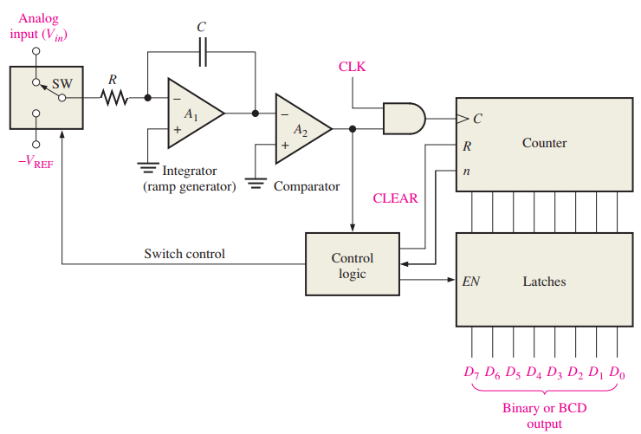

12.2. Methods of Analog-to-Digital Conversion
Dual-Slope Analog-to-Digital Converter
Chapter 12: Signal Conversion and Processing

Slide 14
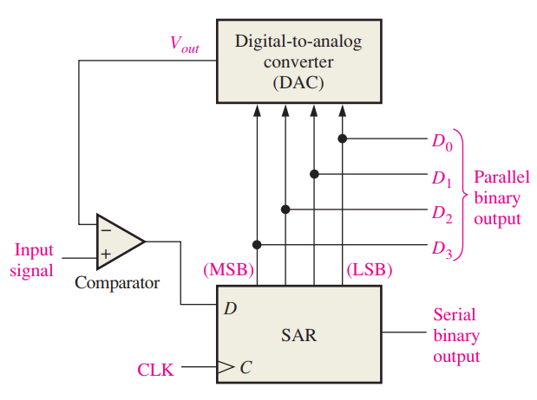
12.2. Methods of Analog-to-Digital Conversion
Successive-Approximation Analog-to-Digital Converter
Chapter 12: Signal Conversion and Processing

Slide 15
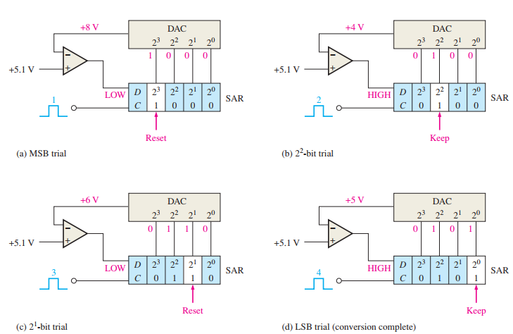
12.2. Methods of Analog-to-Digital Conversion
Successive-Approximation Analog-to-Digital Converter
Chapter 12: Signal Conversion and Processing

Slide 16
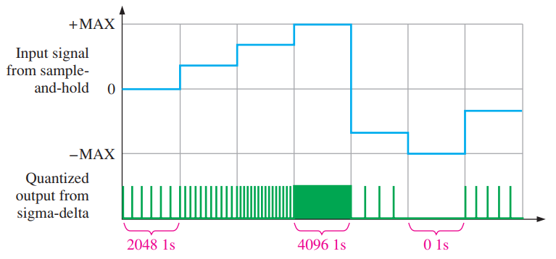
12.2. Methods of Analog-to-Digital Conversion
Sigma-Delta Analog-to-Digital Converter
Chapter 12: Signal Conversion and Processing

Slide 17
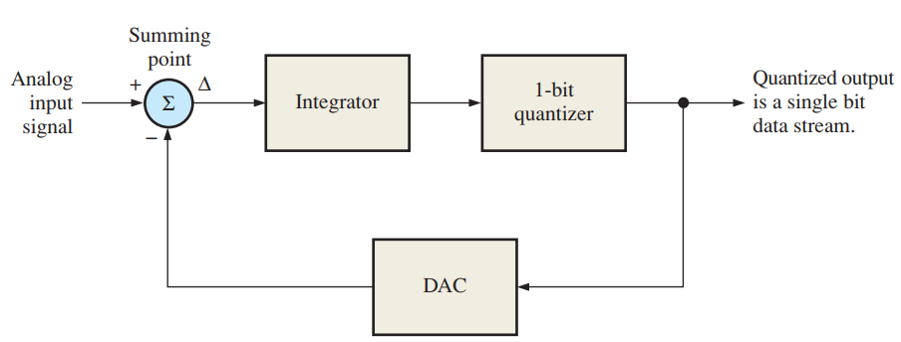
12.2. Methods of Analog-to-Digital Conversion
The Sigma-Delta ADC Functional Block Diagram
Chapter 12: Signal Conversion and Processing

Slide 18
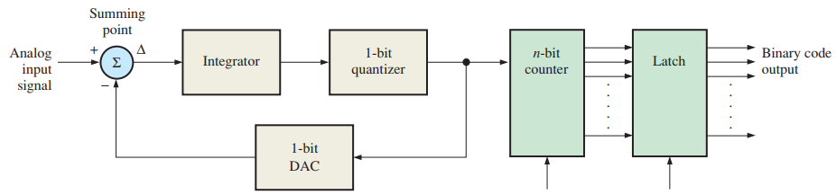
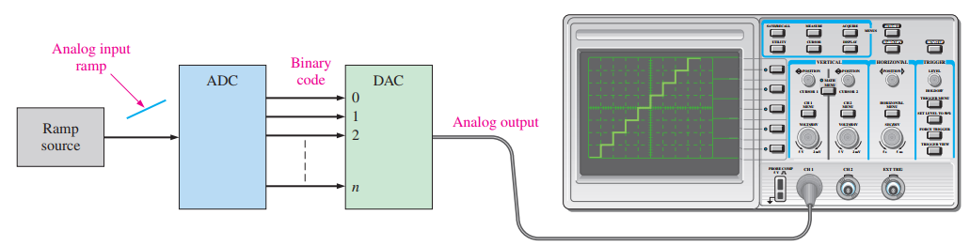
12.2. Methods of Analog-to-Digital Conversion
Testing Analog-to-Digital Converters
Chapter 12: Signal Conversion and Processing

Slide 19
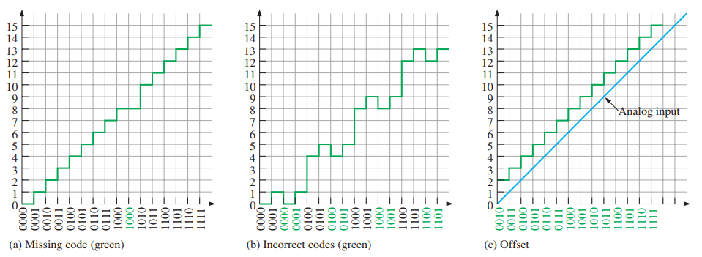
12.2. Methods of Analog-to-Digital Conversion
Analog-to-Digital Conversion Errors In a flash ADC, for example, a failure of one of the op-amp comparators can cause a missing-code error.
Chapter 12: Signal Conversion and Processing

Slide 20
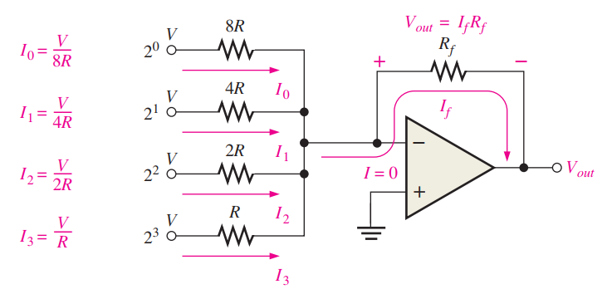
12.3. Methods of Digital-to-Analog Conversion
Binary-Weighted-Input Digital-to-Analog Converter
Chapter 12: Signal Conversion and Processing

Slide 21
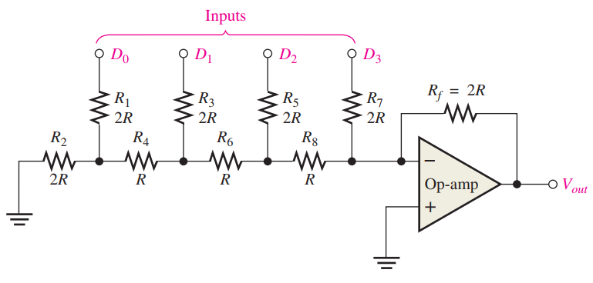
12.3. Methods of Digital-to-Analog Conversion
The R/2R Ladder Digital-to-Analog Converter
Chapter 12: Signal Conversion and Processing

Slide 22
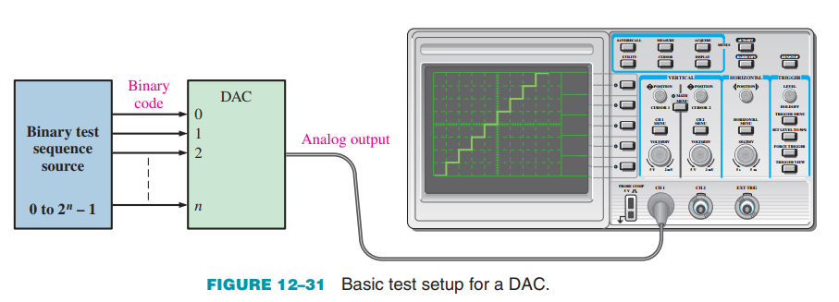
12.3. Methods of Digital-to-Analog Conversion
Testing Digital-to-Analog Converters
Chapter 12: Signal Conversion and Processing

Slide 23
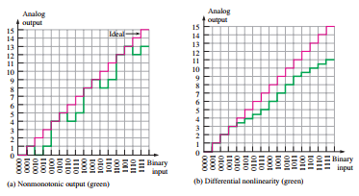
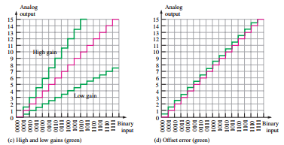
12.3. Methods of Digital-to-Analog Conversion
Digital-to-Analog Conversion Errors
Chapter 12: Signal Conversion and Processing

Slide 24
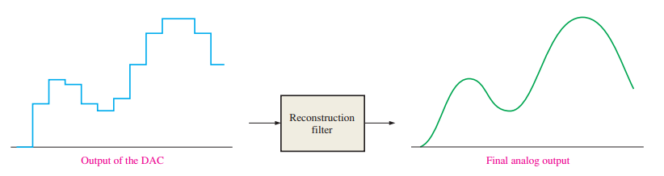
12.3. Methods of Digital-to-Analog Conversion
The Reconstruction Filter
Chapter 12: Signal Conversion and Processing

Slide 25
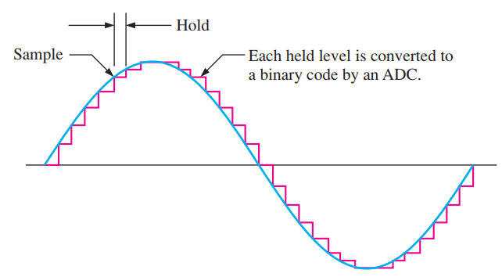
12.4. Digital Signal Processing
What is DSP? DSP converts analog signals (e.g., sound, video, sensor data) into digital form.
Enables enhancement, filtering, and transformation of signals for various applications.
Chapter 12: Signal Conversion and Processing

Slide 26
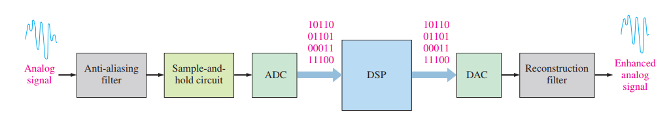
12.4. Digital Signal Processing
Digital Signal Processing System – Block Diagram DSP is a specialized, high-speed processor used for real-time computational tasks.
The entire system converts analog signals into digital form → processes them → then outputs a high-quality analog signal.
Chapter 12: Signal Conversion and Processing

Slide 27
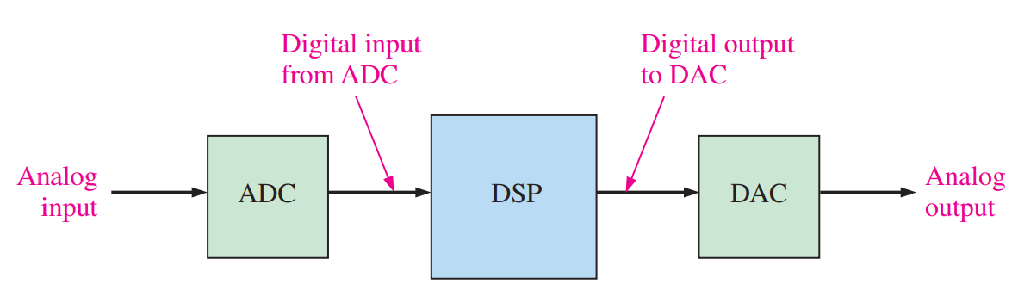
12.5. The Digital Signal Processor (DSP)
DSP in Signal Processing
Chapter 12: Signal Conversion and Processing

Slide 28
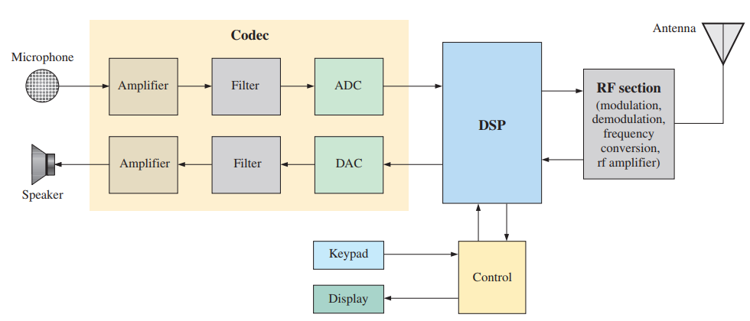
12.5. The Digital Signal Processor (DSP)
The DSP in a Cellular Telephone
Chapter 12: Signal Conversion and Processing

Slide 29
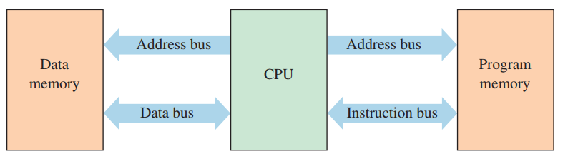
12.5. The Digital Signal Processor (DSP)
Basic DSP Architecture
Chapter 12: Signal Conversion and Processing

Slide 30
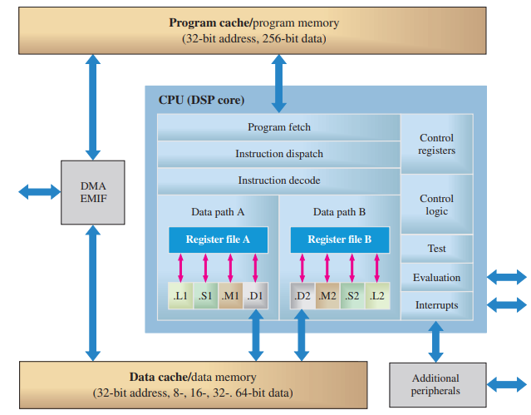
12.5. The Digital Signal Processor (DSP)
A Specific DSP
Chapter 12: Signal Conversion and Processing

Slide 31
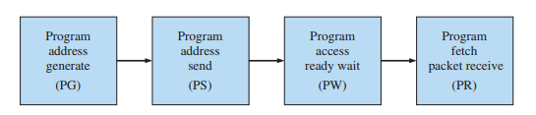
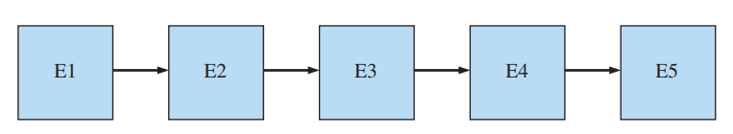
12.5. The Digital Signal Processor (DSP)
Pipeline
Chapter 12: Signal Conversion and Processing

Slide 32
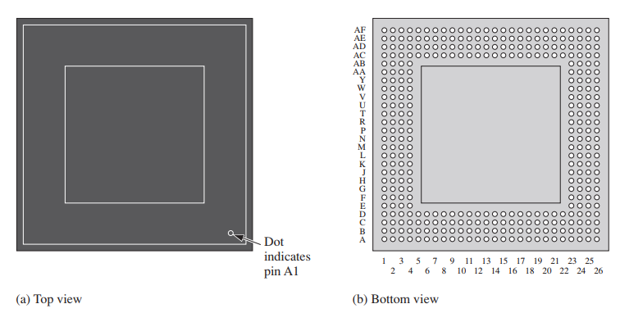

12.5. The Digital Signal Processor (DSP)
Packaging
Chapter 12: Signal Conversion and Processing

Slide 33
SUMMARY
Chapter 12: Programmable Logic
1. Sampling & Nyquist Theorem
Sampling converts an analog signal into discrete pulses representing amplitude.
The sampling frequency must be at least twice the highest frequency (Nyquist theorem).
2. ADC & DAC Conversion
ADC converts analog signals to binary codes.
DAC converts digital codes back into analog signals.
3. Digital Signal Processing (DSP)
DSP refers to processing analog signals in digital form, usually in real time, for the purpose of enhancing or modifying the signal.
4. DSP System Architecture
Includes: Anti-aliasing filter, Sample-and-hold circuit, ADC, DSP, DAC, and Reconstruction filter.
5. DSP Architecture Features
DSP is a specialized processor, optimized for speed and real-time data processing.
Typically based on the Harvard architecture (separate program and data memory).
Supports pipeline operation: fetch, decode, and execute stages.
Chapter 12: Signal Conversion and Processing

Slide 34
MULTIPLE-CHOICE TEST AND PROBLEMS
Complete the true/false questions, multiple-choice questions, and end-of-chapter exercises in the primary textbook.

